Slide 1

Mortgage Approval Prediction System
-Dhruv Prajapati
-Chetan Bhanushali

Slide 2

Introduction to Dataset
Home Mortgage Disclosure Act (HMDA) dataset contains detailed information about mortgage applications in the United States, including loan characteristics, applicant demographics, property details, and the outcomes of loan applications.

Slide 3
Objectives
Exploratory Data Analysis to find
Loan Approval Trends: Identify patterns in approval/denial rates based on geography, lender, or applicant demographics.
Borrower Demographics: Investigate if certain groups have higher denial rates or access to less favorable loan terms.
Geographic Trends: Analyze loan distribution across states, counties.
Predict Loan application approval
Estimate the interest rate of an application

Slide 4
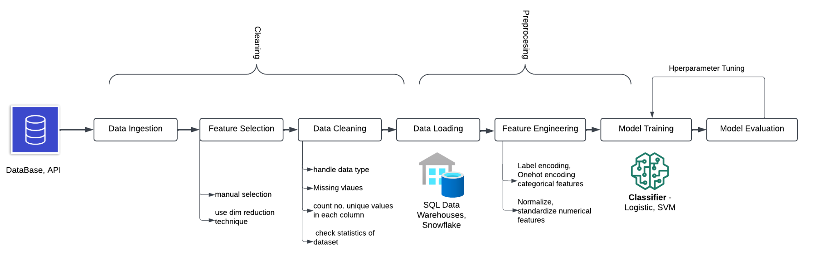
The Approach

Slide 5
Data Cleaning Techniques
To ensure reliable analysis, we applied several data cleaning methods:
Missing Values: - Identified and handled missing data
Used imputation techniques to fill gaps
Duplicates: - Removed duplicate records to avoid skewed results
Inconsistencies: - Standardized data formats and corrected inconsistencies
Data cleaning ensures the dataset's accuracy and reliability.

Slide 6
Data Preprocessing Steps
Preprocessing prepares the data for model training:
Data Normalization: - Scaled numeric features to a common range
- Ensures fair comparison between features
Encoding Categorical Variables: - Converted categorical data into numerical format
- Used techniques like one-hot encoding
Splitting the Dataset: - Divided data into training and testing sets
- Training set: 80%, Testing set: 20%
Preprocessing is crucial for effective model training.

Slide 7

Feature Engineering Insights
Feature engineering enhances model accuracy:
Generated new features from existing data
Examples: Loan-to-Value ratio, Debt-to-Income ratio
Improved model's ability to predict loan approval
Identified key factors influencing loan decisions
Feature engineering adds valuable insights to the dataset.

Slide 8
Model Prediction and Results
Logistic Regression
Decision Trees
Random Forest
Accuracy, Precision, Recall, F1-Score
One of the models used for prediction
Another model used for prediction
Model with the highest accuracy
Performance metrics used to evaluate models

Slide 9
Conclusion and Implications
Key Findings
Implications for Lenders
Future Studies
- Data cleaning and preprocessing are essential for reliable analysis
- Feature engineering significantly improves model accuracy
- Random Forest model is effective in predicting loan approval
- Better understanding of factors influencing loan approval
- Informed decision-making in mortgage lending
- Explore additional features and models
- Continuous improvement of prediction accuracy
Our analysis provides valuable insights for the mortgage lending industry.

